Slide 1

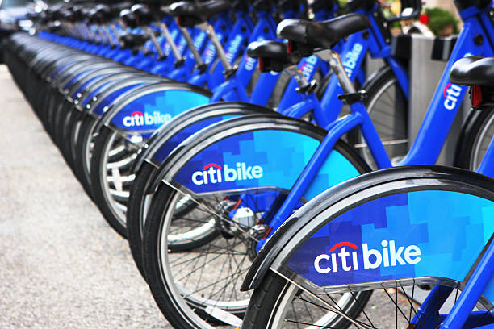
Introduction
This data was retrieved from the Citi Bike system data. The Citi Bike trip data is collected monthly. The trip history houses trip duration (seconds), start time and date, stop time and date, start station name, end station name, station ID, station latitude and longitude, bike ID, user Type (Customer = 24-hour pass or 3-day pass user; Subscriber = Annual Member), gender (Zero=unknown and year of birth. The data examined was from December of 2019.

Slide 2
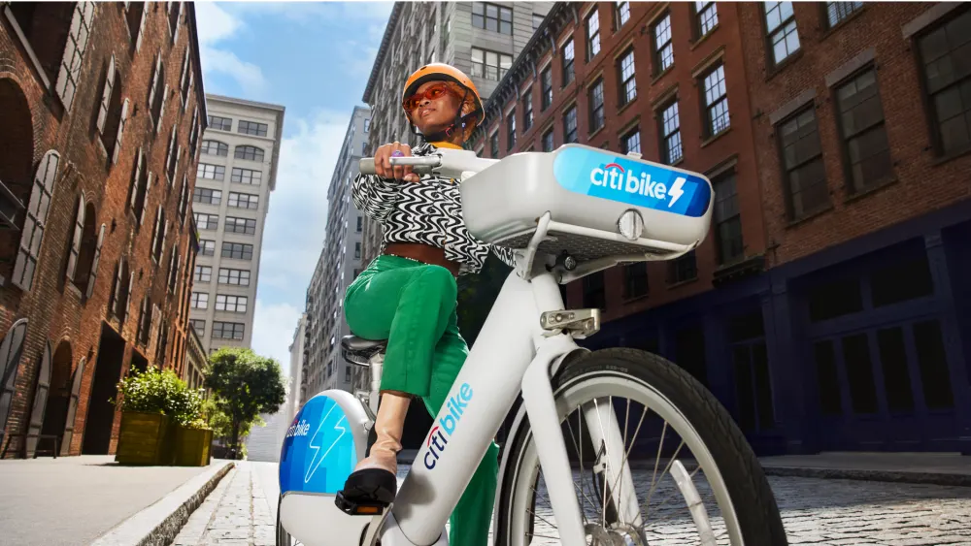


Goal
Examine Citi bike usage by gender, subscription type, stations and birth year.

Slide 3

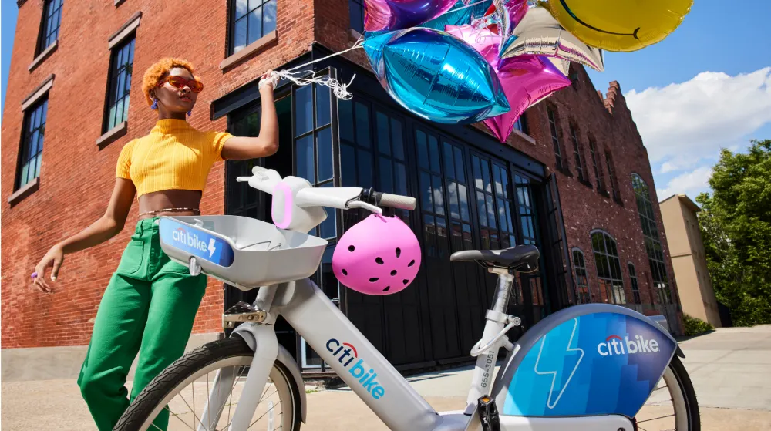
Data sources
Data Rows/Columns
955,210Rows
19 Columns
Sources
Citi Bike Trip History
Links
https://s3.amazonaws.com/tripdata/index.html

Slide 4
Methodologies
Libraries
Methods
Visualizations
Pandas
Matplotlib
Numpy
Seaborn
Changed data type in columns
Replace values in columns
Created a new data frame with necessary columns
Bap Plot
Line Plot

Slide 5
Mean/Description of the data
Feature | Mean
Trip duration | 830 seconds (~13 minutes)
Birth year | 1979
The most frequent start time for a ride was around 8:35 am. The most frequent stop time for a ride was around 8:57 am. The station that is most frequently visited is Pershing Square North is near Grand Central station in NYC.

Slide 6
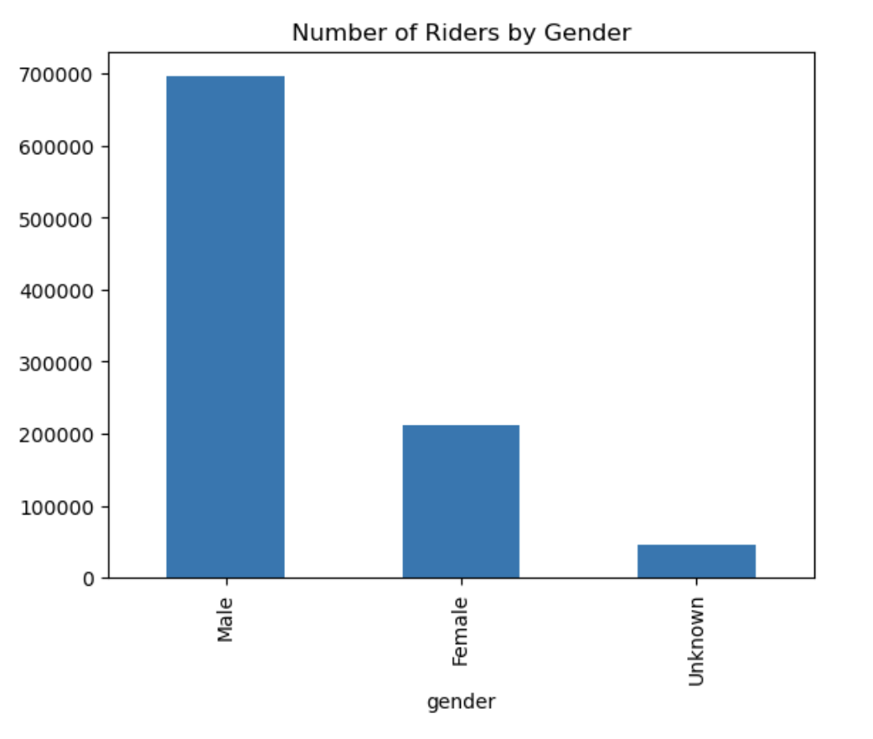
Gender
Males consist of most of the Citi Bike riders. There are about 3.5 times more male riders that female riders.

Slide 7
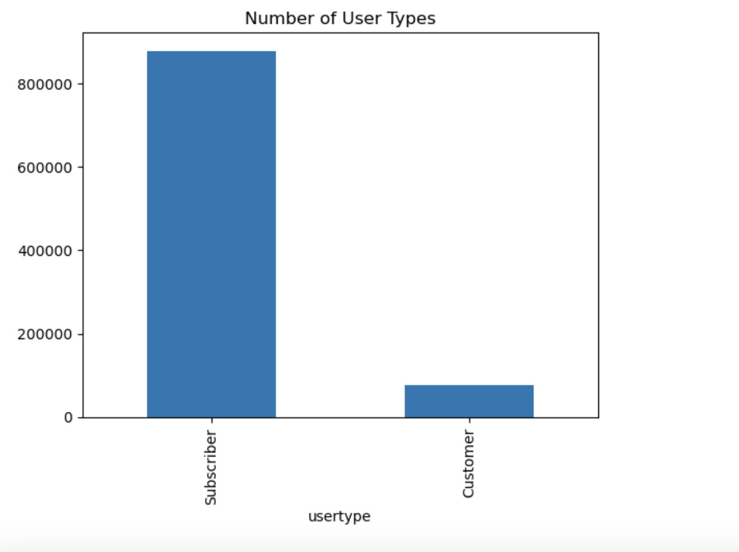
User types
The majority of Citi Bike riders are subscribers.

Slide 8
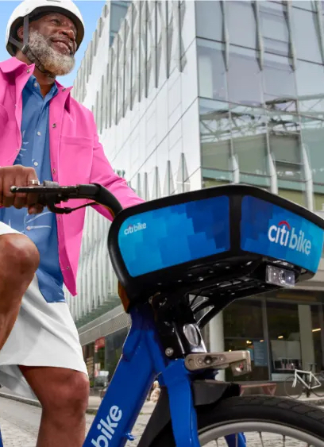
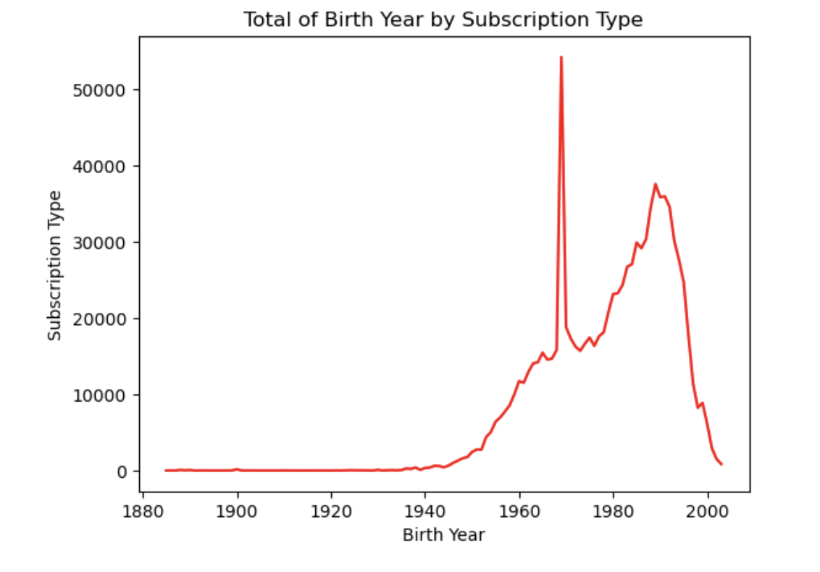
Compare User types by birth year

Slide 9
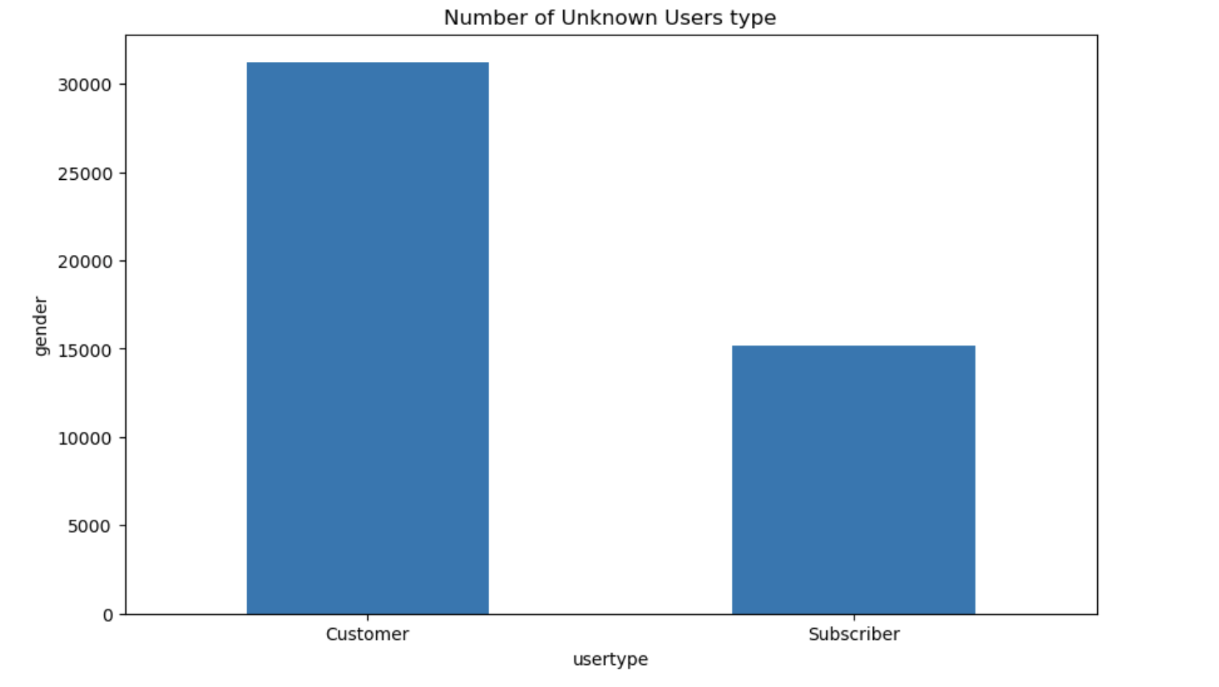
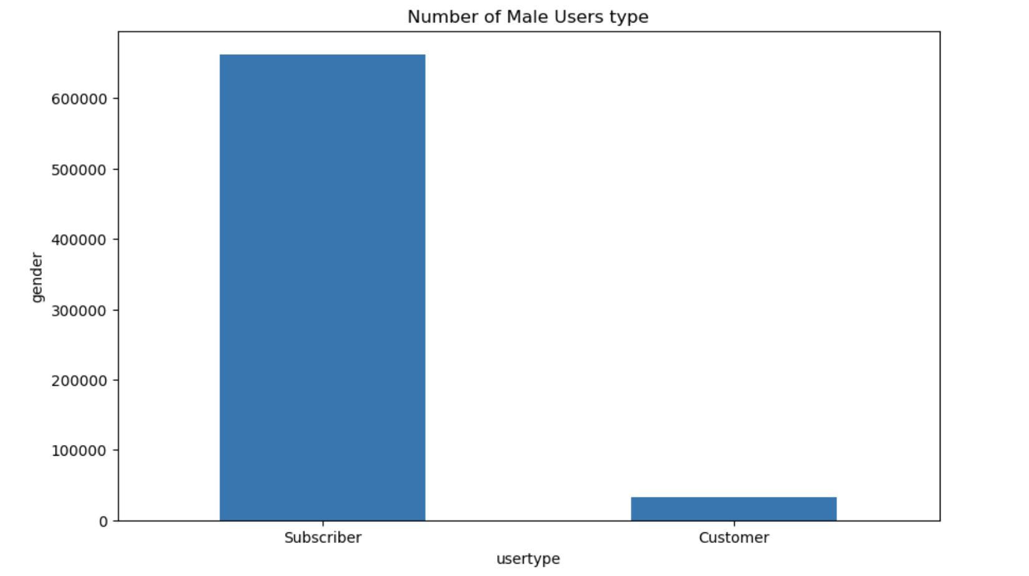
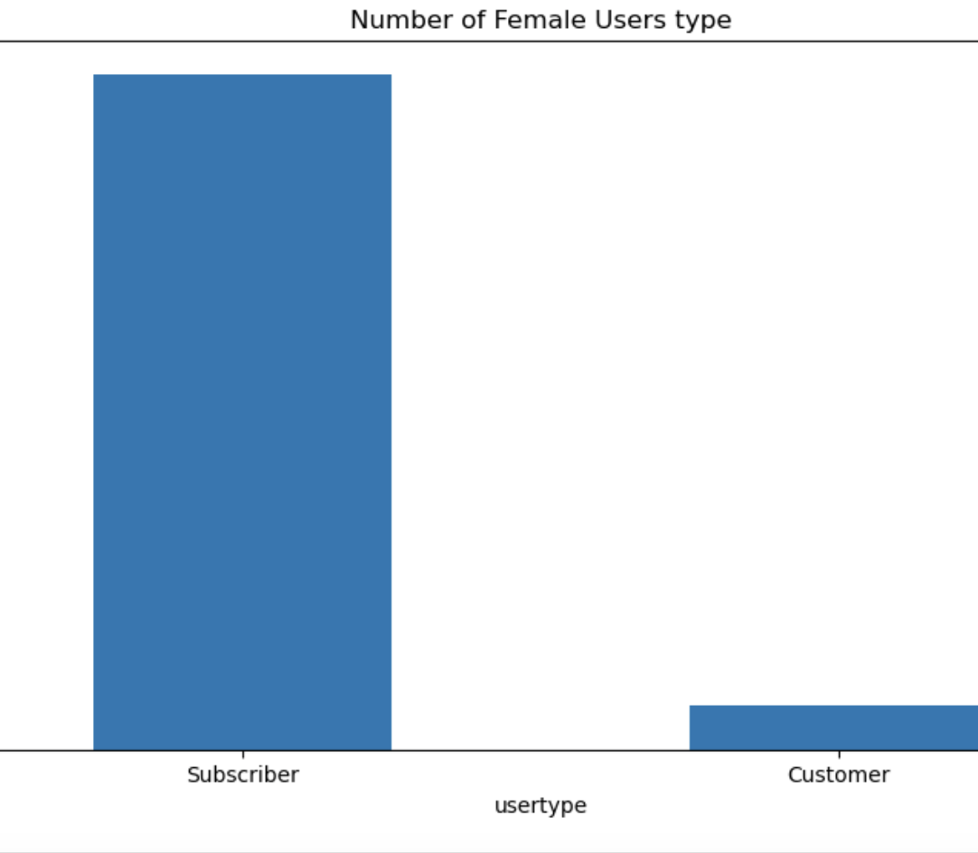
Compare gender by user types
Most of the customer genders are unknown.

Slide 10
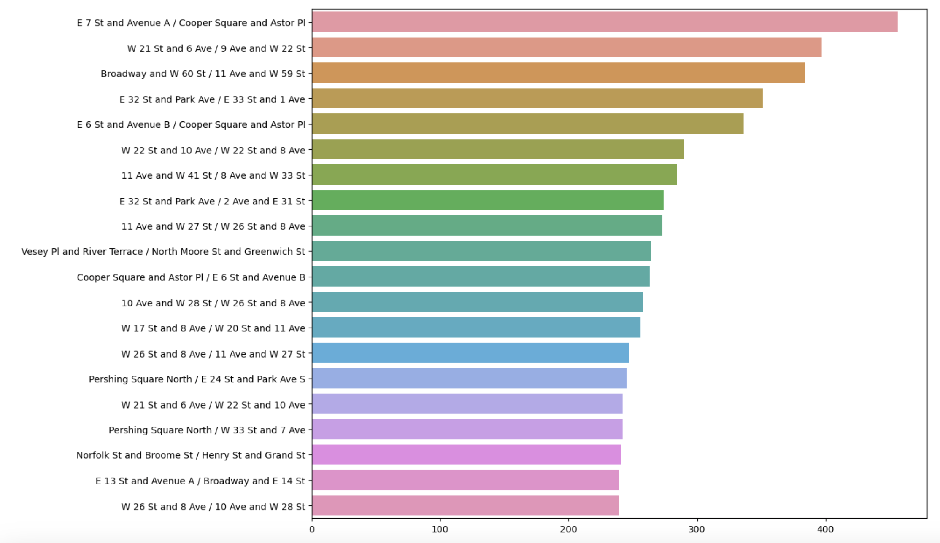
Top Twenty Trips
The address before the back slash is the starting station and after the back slash is the ending station.

Slide 11

Conclusion
The average trip duration was about 13 minutes.
The average birth year is 1979, which makes the average age 40.
Citi bike riders are mostly male.
Most Citi Bike riders are subscribers.
Males are mostly subscribers.

Slide 12




recommendation
Based on the data riders are mostly 40 years of age and consist of males. I would recommend that Citi Bike increase their ridership by advertising to females within NYC.

Slide 13
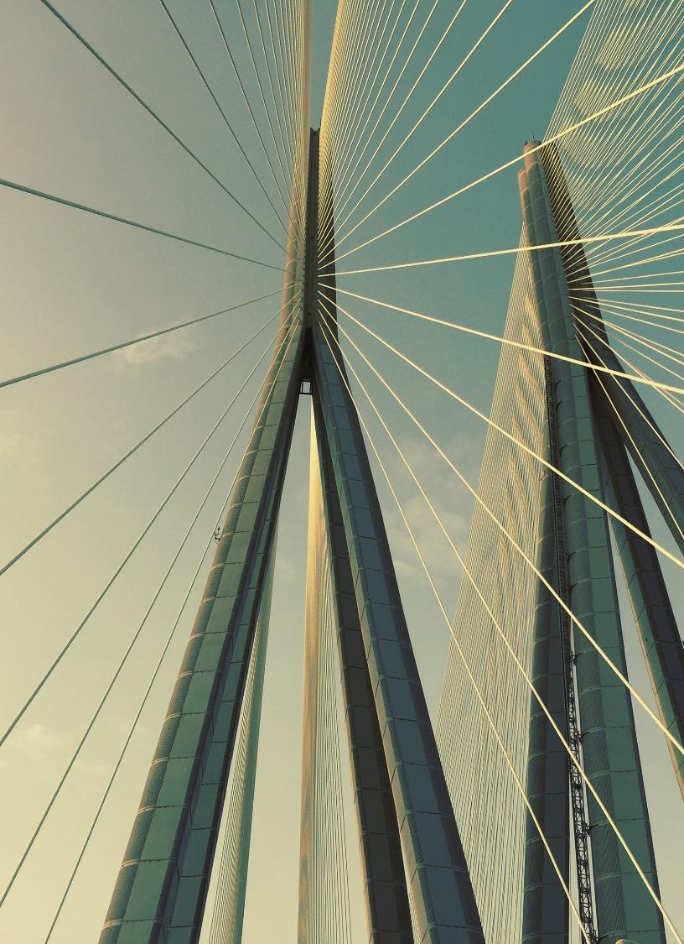
Thank you

